Slide 1
Project Molecule
MAY1739
Advisor: Arun Somani
Ryan Wade, Nathan Volkert, Daniel Griffen, Alex Berns
Notes:
E + RYAN

Slide 2
Project Molecule
Multi-Node Shared Application Environment
For Smart Home Systems
Notes:
RYAN

Slide 3
Problem Statement
Smart home networks are
Cloud Dependent
  Single Point of Failure
  Security Concerns
Have Competing Standards
  Expensive to Configure or Install
  Numerous Smart-Home Apps
Notes:
DANIEL

Slide 4
Project Goals
Locally Distributed (Multi-Node)
Open Source Standard
Unified Application Interface
Fault Tolerant by Design
Notes:
ALEX
Not Cloud
Community Driven
API
Don’t assume it will work

Slide 5
Design and Testing Methodology
Iterative Design
  Review past work
  Assign new and continuing work
Testing
  Continuous Integration
  Automated Regression Testing
Notes:
NATHAN
Scrum like
Assigned work
Regression Testing

Slide 6
Conceptual Sketch – Fall 2016
High Level Layered Architecture
Message Based System
Strict Particle Types
Notes:
ALEX
Discuss the changes that brought us to this final version
Changing Bonding layer to Networking Layer
Adding Quark definition

Slide 7
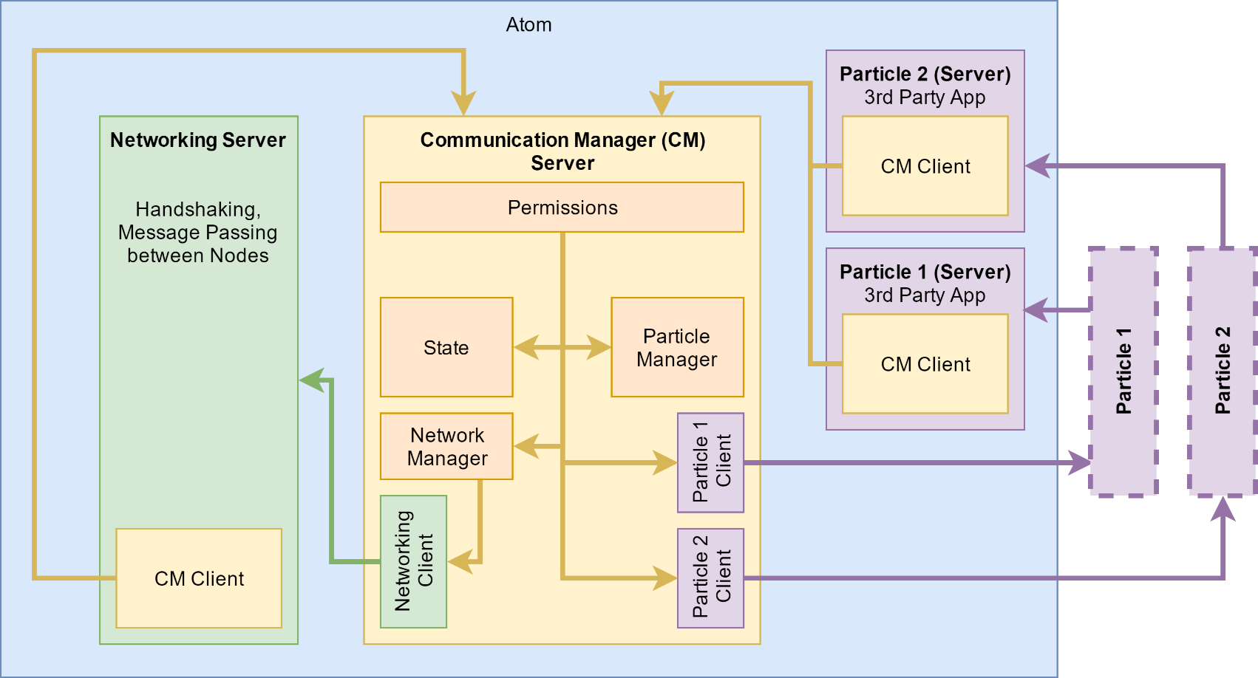
System Architecture – Spring 2017
Client Server Model Between Layers
Atom + Network Integration
Runtime Particle Differentiation
Notes:
RYAN
Abandoned strict differentiation between particles
Differentiation
Discuss the changes that brought us to this final version
Changing Bonding layer to Networking Layer
Adding Quark definition

Slide 8
Particles Considered in Design
Alarm Clock
Media Player
Light Control
Appliance Control
Door Lock
Notes:
NATHAN
Shared
Shared
Responsive – Lighting Profiles
Responsive
Security

Slide 9
Problems Identified
Event Synchronization
  Multiple Alarm Clock Instances
Bad Particle Actor
  App inappropriately controls Door Lock
Byzantine Faults
Notes:
ALEX

Slide 10
High Level Solutions
App State Shared between Nodes
  onChange Listeners
Messages classified as Actions
Permissions gatekeep Actions
  Who can send/receive them
Don’t cover Byzantine Faults
Notes:
ALEX

Slide 11
Permissions – Further Considerations
When should permissions be defined?
  Coffee Maker Scenario
How to Store?
  Manifest Files
  Database
  Hybrid
Notes:
NATHAN

Slide 12
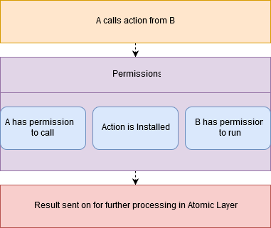
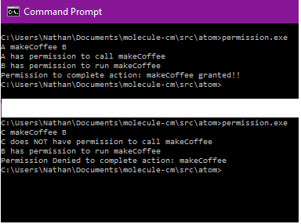
Permissions – Demo
Notes:
NATHAN

Slide 13
State – Specification
Key Value Store
Access Control
History
Notes:
RYAN

Slide 14
State – Further Considerations
Where to Store the data?
  Custom Implementation
  Database
Ease of Use
Asynchronous
Notes:
RYAN

Slide 15
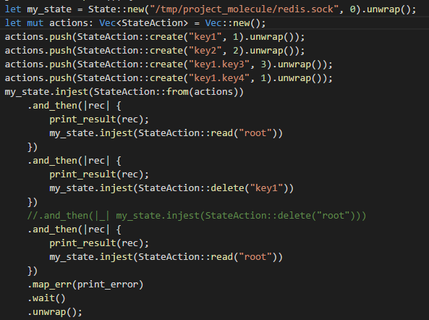
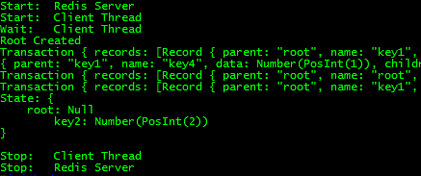
State – Demo
Notes:
RYAN

Slide 16
Networking Layer – Problems Identified
Unavailable Node
Divided Network
Bridged Network
Notes:
DANIEL

Slide 17
Networking Layer – Specification
Full Mesh
Abstracted Routing
Data Messages
  All, Some, One, or Any
Notes:
DANIEL

Slide 18
Networking Layer – Further Considerations
System State Moved to Atomic Layer
Added Message Stream
Added Quorum Messaging
Async/Futures based implementation
Notes:
DANIEL

Slide 19
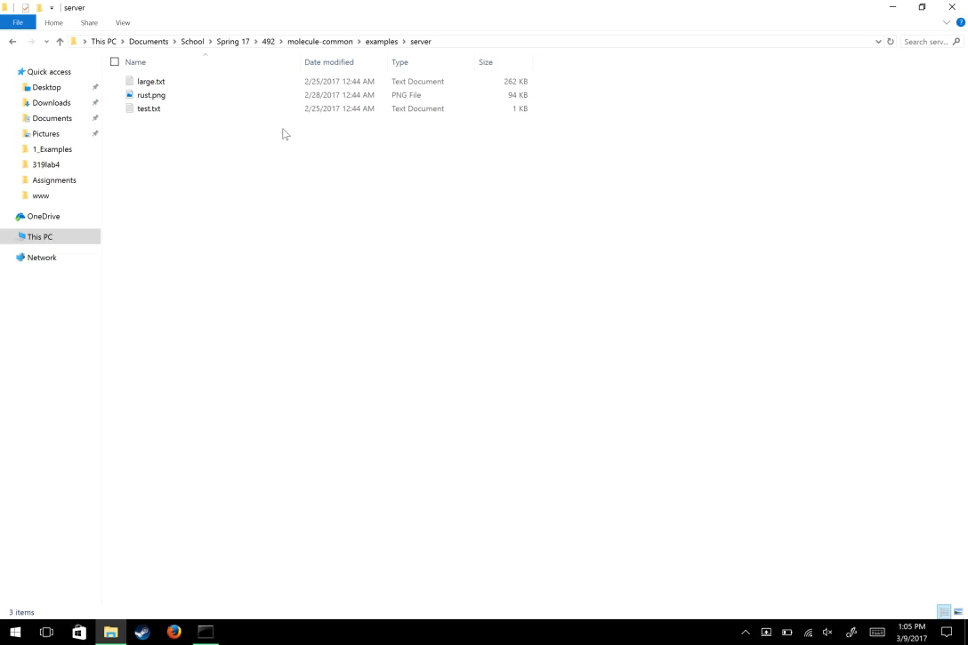
Notes:
DANIEL

Slide 20
Reassessment of Features
UI initially a core feature
Feature Creep – reexamine scope
Reprioritized as a stretch goal
Development postponed
Notes:
ALEX

Slide 21
Current Status - Integration
Network
Permissions
State
Integration
Particle Demos
State Synchroniz-ation
Notes:
NATHAN

Slide 22
Conceptual Sketch – Fall 2016
Notes:
Discuss the changes that brought us to this final version
Changing Bonding layer to Networking Layer
Adding Quark definition

Slide 23

System Architecture – Spring 2017
Notes:
Abandoned strict differentiation between particles
Differentiation
Discuss the changes that brought us to this final version
Changing Bonding layer to Networking Layer
Adding Quark definition

